Slide 1
Window Certifications: What’s In A Label?
A Brief Look at Window Certification Programs of Relevance
To Passive House Design in the US
Prepared by Alison Ray of Alpen HPP
For the North American Passive House Conference
October 19, 2013

Slide 2
OVERVIEW
Introduction
Why Certify?
Structural Performance Certifications
Thermal Performance Certifications
Passive House Certifications
Other Window Certifications
Closing Thoughts: Open Discussion

Slide 3
WHY CERTIFY?
Accurate, Useable Performance Data
Product Comparison
Validation
Code Compliance
Manufacturer Credibility
Quality Assurance
Energy Efficiency & Comfort
Durability & Longevity
Purchase guarantee
Occupant safety and well being
Certifications can serve as assurance of performance, providing designers and homeowners freedom to focus on other valuable elements like color, style and material use

Slide 4
PRESENTATION OVERVIEW
STRUCTURAL PERFORMANCE
THERMAL PERFORMANCE
PASSIVE HOUSE
SIMULATION
PHYSICAL TESTING
FULL WINDOW TESTING
INSULATED GLAZING CERTIFICATION
ACTUAL INSTALLED PERFORMANCE
CERTIFICATION AGENCIES
AAMA, NFRC, PHI, PHIUS, IGCC/IGMA, WDMA, NAMI, CSA, BFRC….

Slide 5
STRUCTURAL PERFORMANCE

Slide 6
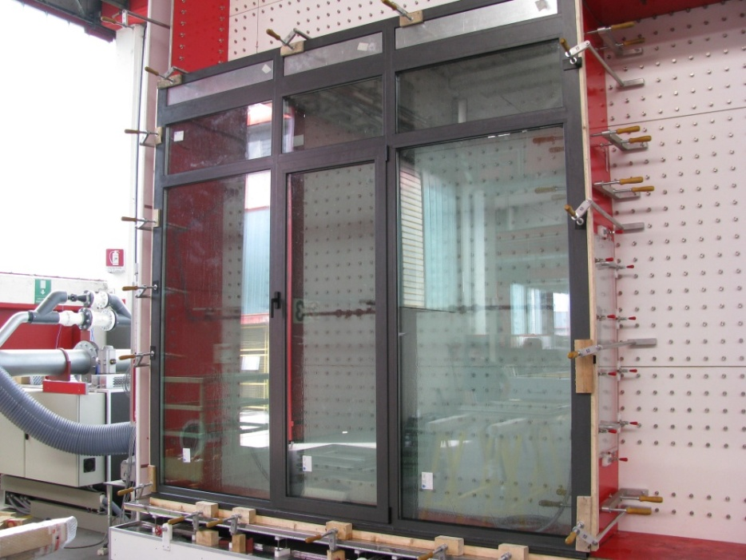
STRUCTURAL PERFORMANCE
Commonly refers to:
Performance Grade (R, LC, CW, AW)
Design Pressure
Air Infiltration Resistance
Water Infiltration Resistance
Deflection – CW & AW only
New to 2012 IRC/IBC: All fenestration products must be AAMA/WDMA/CSA 101/A440-11 tested and labeled
Sample image of physical testing (www.officinetosani.com)

Slide 7
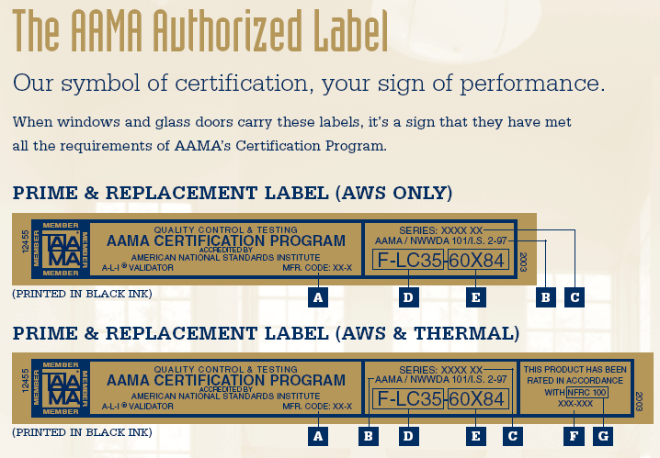
STRUCTURAL CERTIFICATIONS: NORTH AMERICA
US & Canada:
North American Fenestration Standard
AAMA including Gold Label
WDMA including Hallmark
CSA A440
Purpose: to establish and provide a
material-neutral metric for rating
window durability, safety, strength
and longevity in service.

Slide 8
BEHIND A STRUCTURAL PERFORMANCE LABEL: AAMA GOLD EXAMPLE
AAMA Gold Label
Manufacturing/Plant Controls
Physical Testing
Thermal Certification
Plant Inspections (2x per year)
Full Window
Components Testing
NFRC Certification
Equipment Calibration
Initial Test (every type, every class)
Verified Component Database (suppliers)
Simulation
Quality Assurance Program Inspection
Quality Control
Renewal Certification (every 4 years)
Full-Window Physical Test (every 4 years)
IG Certification
ASTM E 2190 (by window mfg. or IG supplier)
Verified Component Compliance Review
Random In-Line Product Testing (during audits or mfr. QC prog. cycle)
IG Certification Prog. Reqmnts
Quality Assurance
Notes:
To illustrate what goes into a thermal performance rating, use NFRC as example b/c it’s the one I know best

Slide 9
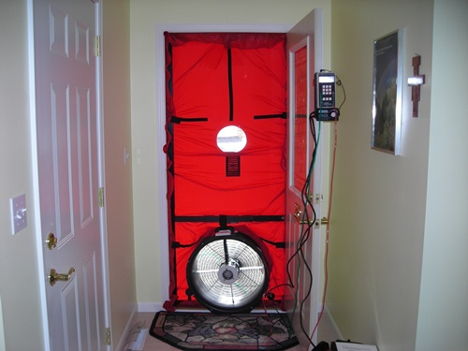
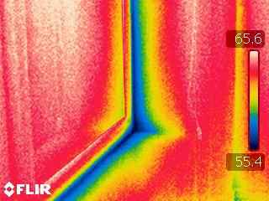
STRUCTURAL PERFORMANCE: PASSIVE HOUSE
Passive House:
Applicable code-required certifications/performance classifications (could utilize AAMA/CSA/WDMA testing)
Physical testing of actual installed windows
Blower Door
Infrared Camera
PHIUS+ & PHI Rater Inspection Checklists
Others?

Slide 10
THERMAL PERFORMANCE

Slide 11
THERMAL PERFORMANCE
Describes:
Energy Efficiency & Comfort
Function of Heat Loss/Heat Gain
Measured by:
U-Value (R-Value)
Solar Heat Gain Coefficient
Visible Light Transmission
Condensation Resistance
Air leakage
Notes:
Thermal performance primarily expresses the capability of a window to provide energy efficiency and comfort by rating its physical properties of heat loss and heat gain.

Slide 12
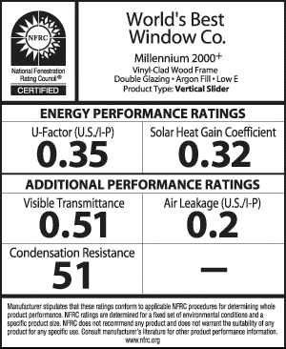
THERMAL CERTIFATION: US
United States
NFRC
NFRC Rating System (1989)
Whole Window
Standardized sizes, vary by type
Fixed/Picture: 47” x 59”
Casement: 24” x 59”
Required for IBC, IRC, IECC code
To claim higher-than-default-table perf
Simulation and Physical Testing
ISO 15099 / NFRC 100-2010
2010: Mandatory IG Certification
Notes:
It is significant to note that the NFRC established whole-assembly test requirements to avoid misleading center of glass only enhanced performance claims.
When was Passive House established? After this? Important to note NFRC isn’t “weaker” because of it’s calculation methodology re: whole product/edge of glass.
NFRC standard test sizes established in 2003 to coorelate with NAFS Gateway sizes

Slide 13
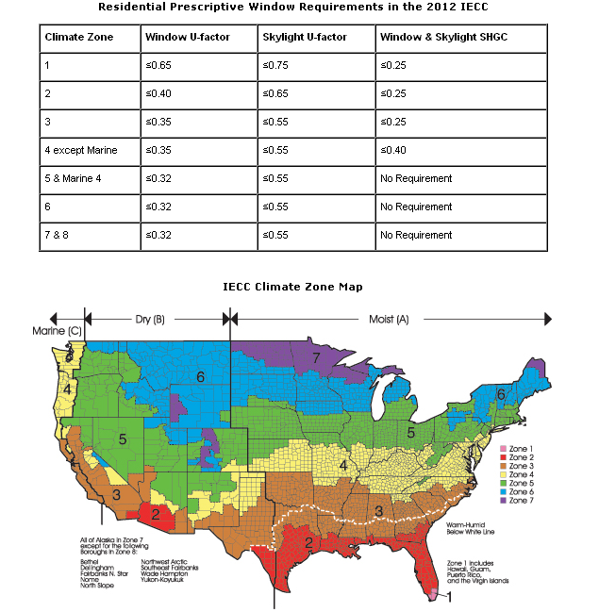
2012 IECC RESIDENTIAL PERSCRIPTIVE WINDOW REQUIREMENTS
“Regardless of chosen compliance path, the following fenestration energy properties are critical for compliance with the code: U-factor, solar heat gain coefficient (SHGC), air leakage, and possibly visible transmittance.
These properties must be provided as certified ratings determined by independent laboratories in accordance with National Fenestration Ratings Council (NFRC) standards. “
- “Windows for High Performance Commercial Buildings,” University of Minnesota Center for Sustainable Buildings Research, 2013. www.commercialwindows.org
www.efficientwindows.org/standards_codeoverview.php
Notes:
Most US jurisdictions do not write their own building codes, most rely on model codes developed by national entities. 2006 and later based on 8 climate zones, older specify 19 zones. 2012 under consideration currently. NFRC

Slide 14
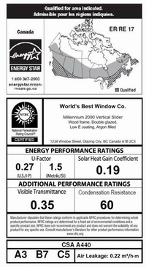
THERMAL CERTIFICATION: CANADA
Canada
CWDMA
CSA A440.2 (NFRC also recognized)
Whole-Window Energy Rating (ER)
Standardized Sizes, Vary by Type
Limited Building Code Requirements
Thermal certification not mandatory in most jurisdictions
IG Testing Optional
ISO 15099 / NFRC 100-2010
Label includes both thermal and structural performance information
Notes:
It is significant to note that the NFRC established whole-assembly test requirements to avoid misleading center of glass only enhanced performance claims.
When was Passive House established? After this? Important to note NFRC isn’t “weaker” because of it’s calculation methodology re: whole product/edge of glass.
NFRC standard test sizes established in 2003 to coorelate with NAFS Gateway sizes

Slide 15
THERMAL CERTIFICATIONS PROGRAMS
European Union
BFRC
Window Energy Rating System (EWERS) – Est. 2001
Whole Window Energy Properties, Standard Sizes by Type
EN 10077, EN 673
Traffic-light style rating system for consumers shows estimated energy loss per year
Advocates selection of high SHGC windows
Image from:
http://www.bfrc.org/consumer/
Notes:
It is significant to note that the NFRC established whole-assembly test requirements to avoid misleading center of glass only enhanced performance claims.
When was Passive House established? After this? Important to note NFRC isn’t “weaker” because of it’s calculation methodology re: whole product/edge of glass.
NFRC standard test sizes established in 2003 to coorelate with NAFS Gateway sizes

Slide 16
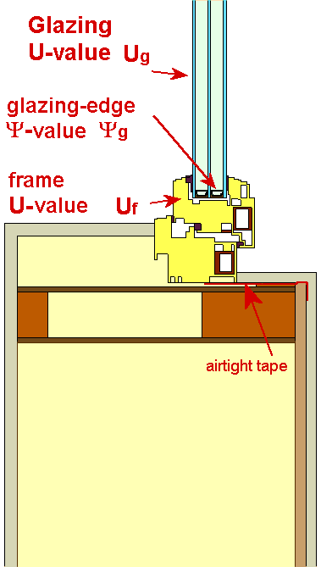
THERMAL CERIFICATIONS: PASSIVE HOUSE
Passive House
PHI & PHIUS
Based on Component, Whole Window and Installed Performance
Whole-window performance, same size for all window types – casement and picture window same
Simulation only (cost-sensitive approach)
EN 10077, EN 673, PHI and PHIUS procedural docs
Provides validated component performance data for PHPP/WUFI
PHI or PHIUS window certification are not prerequisite for whole-building Passive House Certification
Image from Passive House Institute: http://www.passivhaustagung.de/Passive_House_E/window_U.htm

Slide 17
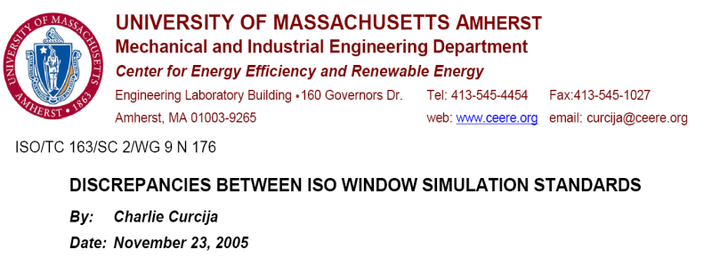
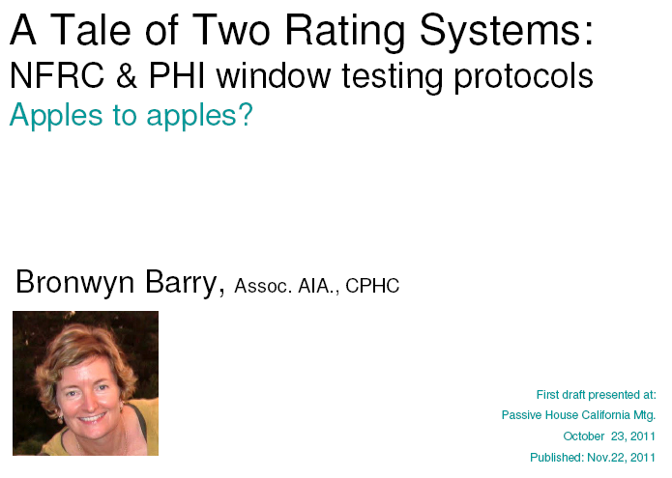
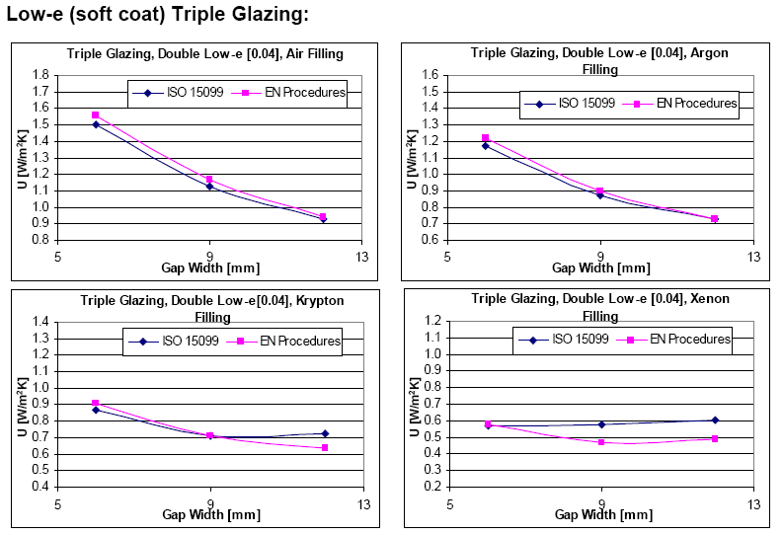
THERMAL PERFORMANCES: DIFFERENCES STANDARDS, DIFFERENT RESULTS
Thermal (U-value) differences well documented
Ongoing international/inter-agency collaborative effort toward crossover programs

Slide 18
BEHIND A THERMAL PERFORMANCE LABEL: NFRC EXAMPLE
Inspection Agency (IA)
AAMA | WDMA | NAMI
Simulation/Modeling
Physical Testing
Whole-Window Thermal Validation Test
Insulated Glazing Unit (IG) Testing
IGCC/IGMA
NFRC
Certified Products Directory
Approved/Certified 3rd Party Test Facility
NFRC Certified Material Database
Component Suppliers/Vendors
Factory Control Programs
Product Data, QC Assurance, Labels, Component Supplier List, Inspections
LBL / IGDB: Glazing
(IGCC/IGMA frequent in commercial specs)
Simulation Lab
Independent/3rd Party
Approved/Certified 3rd Party Test Facility
Notes:
To illustrate what goes into a thermal performance rating, use NFRC as example b/c it’s the one I know best

Slide 19
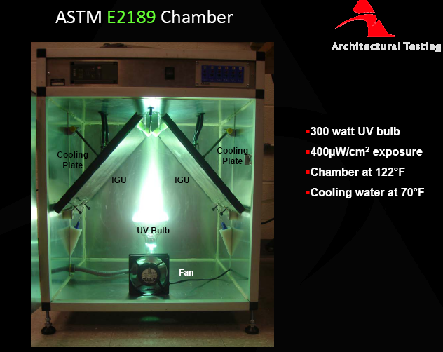
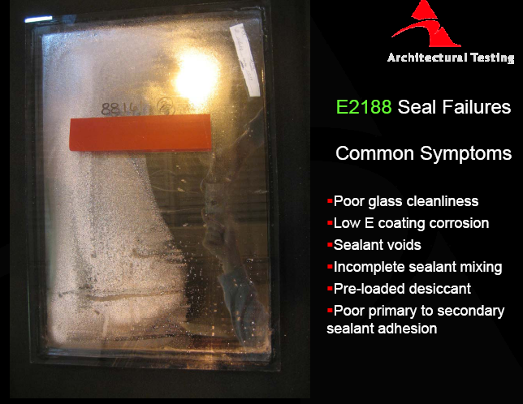
NFRC IG CERTIFICATION PROGRAM
2010 - NFRC 706: Mandatory use of independently tested and certified IGs
Testing and Inspections – Rigorous, Thorough and Frequent
Manufacturer Responsibilities
Pass bi-annual in-plant inspections
Maintain documented, inspected quality assurance programs
Follow all requirements for proper labeling and reporting
Physical testing every 2-years – IG durability and gas containment
EG: ASTM E 2190 (among other standard tests)
Images from Northeast Window & Door Association, “Insulating glass units and how they fail testing.” www.nwda.net/presentations/10%20QC%20Fill%20Rate.pdf

Slide 20
IG CERTIFICTION ASTM E 2190
ASTM E 2190 is a harmonized standard test protocol adopted by the U.S. and Canada for evaluating insulating glass (IG) performance, durability, and longevity. There are three main parts to the standard:
High Humidity Test subjects samples to high humidity and temperature with the objective of forcing moisture into the sealed air space in an IG unit. Specimens are tested for 42 days and subjected to 95% ±5% relative humidity.
Accelerated Weather Cycling simulates weather cycling from hot to cold extremes with moisture added during the hot cycle. Specimens are tested for 63 days and subjected to 252 cycles.
Volatile Fog Test shows that components, or trapped impurities, will not out-gas a volatile fog, which could result in a deposit on the interior glass surface. No fog must be visible at arm's length

Slide 21
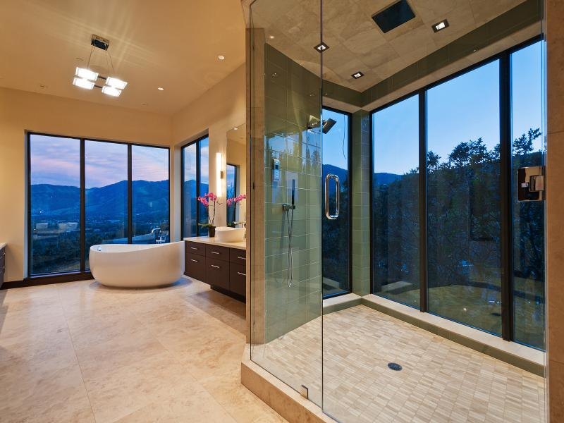
IG TESTING & CERTIFICATION
Even if NFRC ratings are not required on a project, the IG Certification program provides consumers with assurances that insulated glazing units have been tested and manufactured to meet rigorous quality standards.

Slide 22
PASSIVE HOUSE
“The use of high quality building components [like those in the Certified Passive House Component Database] is key, but simply using Passive House suitable components does not make a building a Passive House.”
-”Passive House Certification Criteria,” IPHA
http://www.passivehouse-international.org/index.php?page_id=150

Slide 23
THERMAL CERIFICATIONS: PASSIVE
Passive House
PHI & PHIUS
Based on Component, Whole Window and Installed Performance
Whole-window performance, same size all types
Simulation only (cost-sensitive approach)
EN 10077, EN 673, PHI and PHIUS procedural docs
Provides validated component performance data for PHPP/WUFI
PHI or PHIUS window certification are not prerequisite for whole-building Passive House Certification

Slide 24
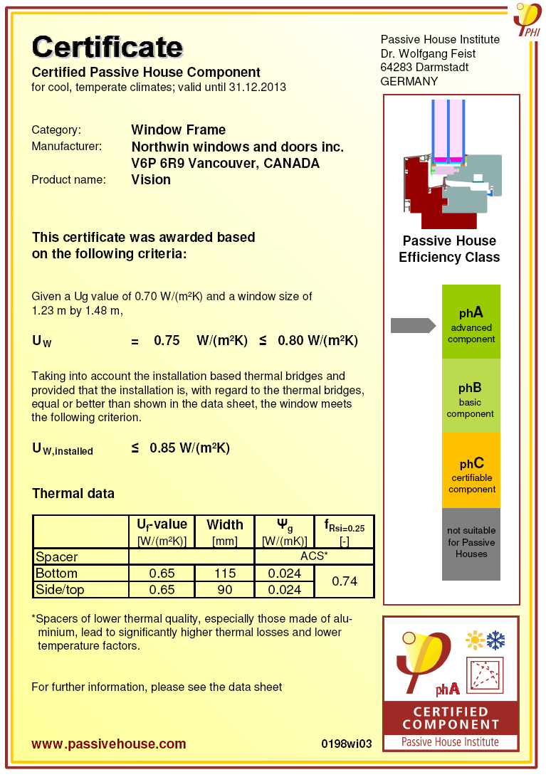
PASSIVE HOUSE INSTITUTE (PHI)
Certified Passive House Component
Simulation and review/validation
PHI provides consultation assistance and simulation of design variants
Publishes results in clear, concise certificate including window, frame, spacer and installation U-values
Product listing on Passive House Institute website component database
Minimum performance requirement:
Uw > 0.80
Uw,install > 0.85
Certified windows mostly European
This year Northwin Windows became one of the first North American window manufacturers to complete certification and become a Certified Passive House Component by PHI
Image from Passive House Certified Component Database, http://www.passiv.de/komponentendatenbank/en-EN

Slide 25
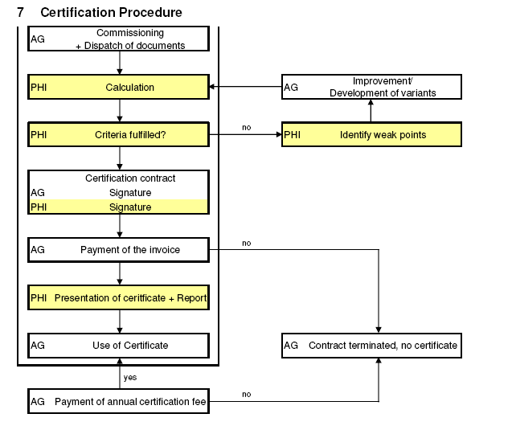
PASSIVE HOUSE INSTITUTE CERTIFICATION PROCESS FOR GLAZINGS AND TRANSPARENT COATINGS

Slide 26
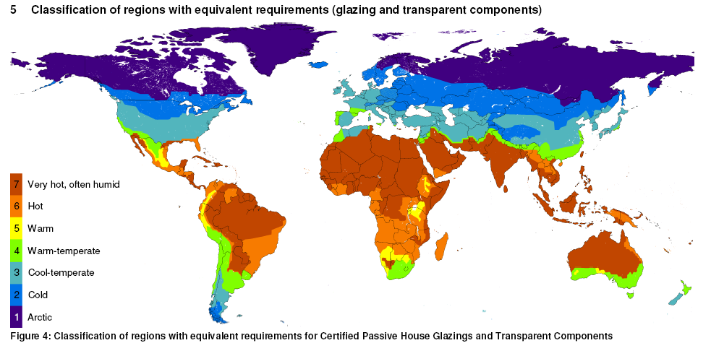
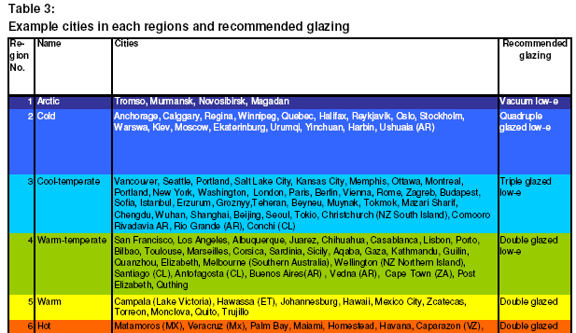
PASSIVE HOUSE INSTITUTE REGIONAL/CLIMATE-ZONE RECOMMENDATION
Image from “Certification Criteria for Certified Passive House Glazings and Transparent Components,” June, 2012. Passive House Institute . http://passiv.de/downloads/03_certification_criteria_transparent_components_en.pdf

Slide 27
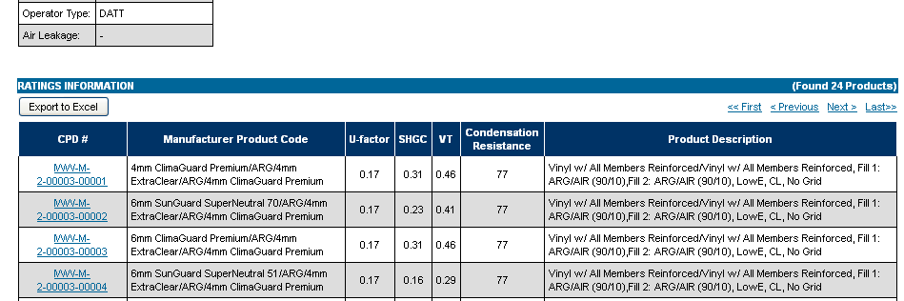
SAMPLE PASSIVE HOUSE TRIPLE PANE WINDOW ACCORDING TO NFRC
An industry leading European uPVC window manufacturer with Passive House certifications on some of their lines has undergone certification and simulations to both PHPP and NFRC rating formats.
This offers a unique opportunity for comparative study of both U-value and SHGC differences between results when modeled to different standards/conditions.
Image from NFRC Certified Product Database: www.nfrc.org

Slide 28
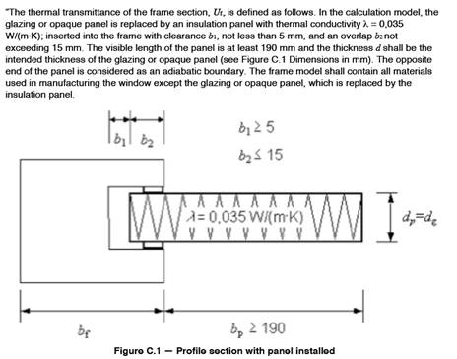
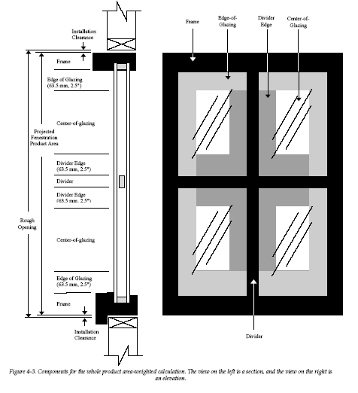
PASSIVE HOUSE INSTITUTE (PHI)
Minimum performance requirement:
Uw > 0.80
Uw,install > 0.85
PHI currently only offers certification for arctic, cold and cold-temperate climates
Simulation procedure and acceptance criteria is a completely different language, method and approach compared to North American programs
Simulation software based on BISCO and WinDat - common to Europe
No opportunity to re-use simulated filesets derived from NFRC cert. process
These factors may contribute to the lack of participation by North American window manufacturers: the program may be perceived as inaccessible, foreign, or too complex/confusing to be appealing or encourage participation. Perhaps the market value is also perceived to be too small?

Slide 29
PASSIVE HOUSE INSTITUTE US (PHIUS) PHIUS Certified Data for Window Performance Program
Established 2012
Facilitate faster adoption of Passive House approach in North America
Expand database of verified performance data in PHPP-ready format
“The initial goal is to calculate and make available valid thermal performance parameters for US windows so that designers have more choices and can do building energy models with more confidence in their accuracy.”
- PHIUS Certified Data for Window Performance Program, Oct. 29, 2012 (http://www.passivehouse.us/passiveHouse/CertifiedWindowData.html)
Notes:
Grow North American market for high performance windows
Give designers a wider range of choices with valid, accurate data in format ready for use in modeling

Slide 30
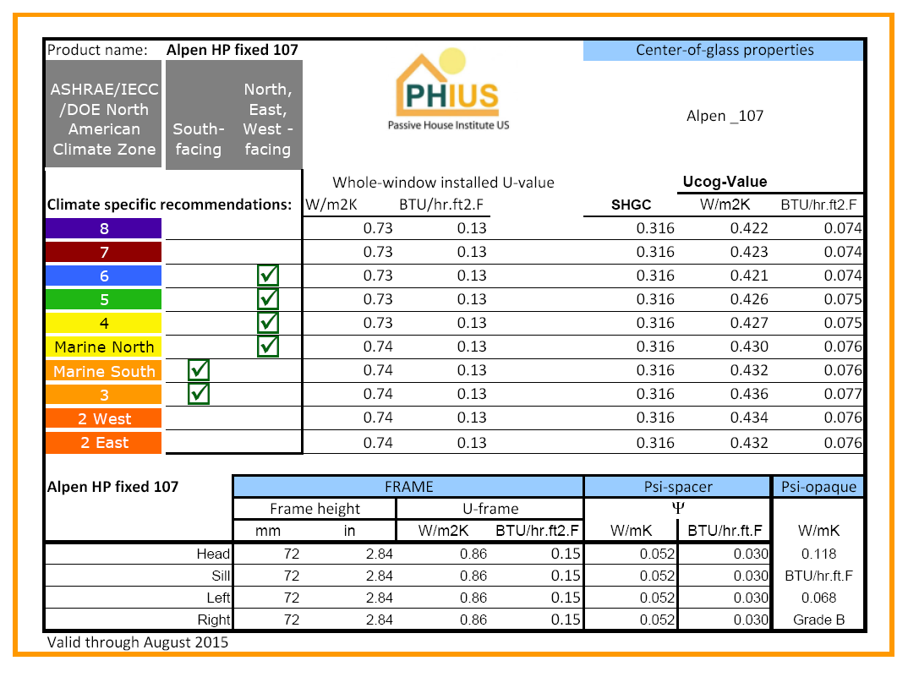
PASSIVE HOUSE INSTITUTE US (PHIUS) PHIUS Certified Data for Window Performance Program
PHIUS-trained simulators model and calculate
PHIUS administrators (at first) and simulator peer-review validate results
Certificate issued for each window type, frame and glazing combination
3 paths for psi-install incl. disclosure/publication of verified THERM models

Slide 31
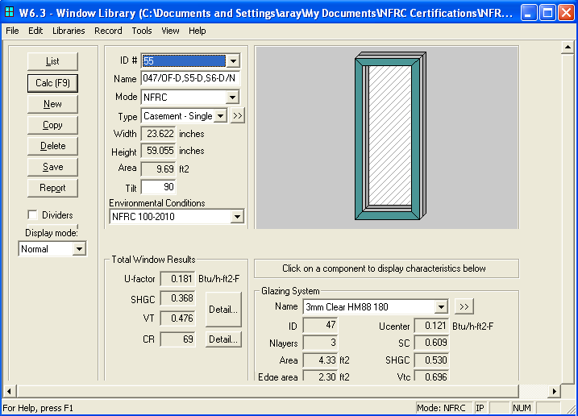
PHIUS CERTIFIED DATA FOR WINDOW PERFORMANCE PROGRAM
Based on LBL WINDOW and THERM software familiar to US manufacturers and modelers
Encouraging exploration of NFRC crossover program opportunities

Slide 32
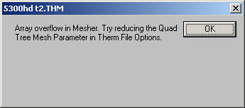
PHIUS CERTIFIED DATA FOR WINDOW PERFORMANCE PROGRAM
Wright 2012 conference paper: to “demyistify” simulation procedure following PHI and LBL docs
PHIUS Program = Critical asset and survival tool for the confused and overwhelmed North American window manufacturer
Notes:
PHPP = new foreign langage, methodology and procedure

Slide 33
PASSIVE HOUSE INSTITUTE US (PHIUS) PHIUS Certified Data for Window Performance Program
Alpen HP was the first North American window manufacturer to complete the certification program. As recent as Monday this week, Alpen HPP received and posted additional certificates for its 925 and 725 Series windows.
There are now 5 North American window manufacturers who have won certification:
Alpen HPP (CO)
Northwin (Vancouver)
Marvin Window & Doors (MN)
Casagrande Woodworks (CA)
Wooden Window Inc. (CA)
And we hope that the list
keeps growing!

Slide 34
OTHER NOTEABLE WINDOW CERTIFICATION PROGRAMS

Slide 35
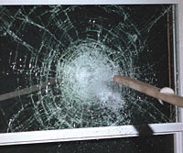
OTHER NOTABLE CERTIFICATIONS
Energy Star and NRCan
Extremely well-recognized throughout the US and Canada, basis for multiple incentives and rebate programs. Although we are “beyond Energy Star” the value of it’s brand recognition alone may merit participation.
LEED
No window-specific certification but windows can contribute in several categories. LEED modeling draws largely from NFRC whole-window performance values.
Living Building Challenge
Fastidious documentation of material composition of every individual element of a window. Notable for its purity in purpose, may be challenging for very high performance windows to achieve.
NFRC’s Component Modeling Approach (CMAST)
Valuable simulation program for rating performances of assemblies created from multiple supplier components
Simulation-only approach is cost-conscious and best suited to respond to increasing use of multi-supplier window assemblies, like commercial windows (frame, glass from others)
Hurricane/Impact Test Certifications
Increasingly important in light of IECC 2012 revised wind maps

Slide 36
CONCLUDING THOUGHTS: OPEN DIALOGUE
Topics I didn’t cover but would have liked to:
Impact of standard size on overall window performance
NFRC Label shows full-frame performance, SHGC and TVis deceptively low
How would Passive House windows with very-wide frame/sash dimensions perform if constrained to the 24”x59” test size?
SHGC: when the battleground is in the second-decimal place arena, is it a fight worth fighting?
Dirt, grime and pigeon poop diminish SHGC
SHGC can be shifted +/- 0.02 simply by changing glass thickness or choosing a supplier of clear float glass vs. default value, or even changing RADIANCE simulation standard settings (EN 673 / ISO 10097)
Tempering and SHGC: tempering does not require special simulation inputs, does not alter the physical properties of the basic float glass, does it have any measurable impact at all?

Slide 37
CONCLUDING THOUGHTS: OPEN DIALOGUE
What have I overlooked?
Can we learn anything from European structural or IG testing?
Is European IG testing & certification similar in style and scope to IGCC/IGMA ASTM E 2190?
How does Passive House engage the structural performance certification component? Are certifications like AAMA Gold important?
What ways might redundancy among certification programs be reduced or streamlined to reduce cost and headache?
What window certifications or performance ratings are most important to the Passive House approach?
Are any of these certifications valuable? How can we present them in the most meaningful way to Passive House designers?

